Slide 1
How Trauma-Responsive Special Education Would reduce disproportionalities and inequities
Derek Johnson
Nicole Tuchinda, JD, MD, LLM
Notes:
Derek goes first
Nicole second
[Nicole has a medical degree]

Slide 2
Our agenda
How black children are underserved by the education and special education systems
Why special education should become trauma-responsive
How to make special education trauma-responsive
For a Child
On a Systemic Level
Notes:
Derek
This is not our presentation, but a collective experience! Please participate as much or little as you like.
Objectives for conversation:
Understand the term disability as described by the IDEA.
Discover the categories of special education under the IDEA.
Discuss some salient statistics with respect to Black students in special education.
Discuss myths and misconceptions of special education, particularly around emotional disturbance, in the Black community.
Start a dialogue to discuss ways to heal and move past myths and misconceptions about special education.
What are some of your goals for today’s discussion? Aim to use whatever people say by highlighting points that they bring up or answering their questions.

Slide 3
Notes:
Derek
I want this to be safe place where folks can have an open dialogue. Please share what you feel comfortable sharing.
We will be discussing trauma, which can be triggering. If you need to take a break to take care of yourself, I won’t be offended.
Be Intentional
Create a Safe Community Space
Discuss Difficult Topics
Leave Feeling Educated and Empowered

Slide 4
Making education trauma-responsive will promote racial justice
Notes:
(Nicole) We intend to show that…

Slide 5
Black students generally still perform significantly less well than white students educationally
Overview of Race and Education:
Notes:
Nicole
When we look at race and education, there is still a significant achievement gap between black and white students.

Slide 6
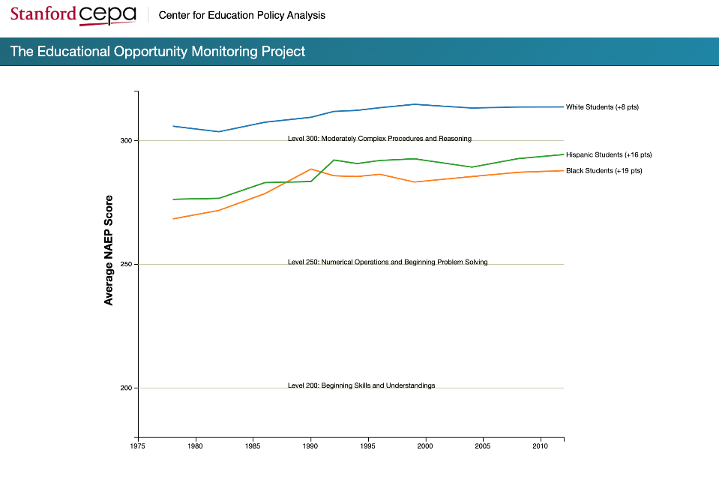
Race and Education
Math scores,
17 year olds
Time
Notes:
Nicole
There is a persistent educational achievement gap between white and black students once children are in school. This slide shows the achievement gap on the NAEP test (National Assessment of Educational Progress) Test. The achievement gap has shrunken since the 1970s, but it still persists and is still close to 1 standard deviation for 12th graders.
For each subject and age group, the figure displays three lines, each of which shows the trend in the average NAEP scores for white, black, or Hispanic students. The vertical axis shows NAEP scores. To help interpret these scores, the horizontal lines indicate the type of skills that students must demonstrate to score at various levels (more detailed information on the NAEP performance levels is available here). Each line’s label (on the right) indicates the overall change in average scores for that group since the first NAEP test shown (in the 1970s).

Slide 7
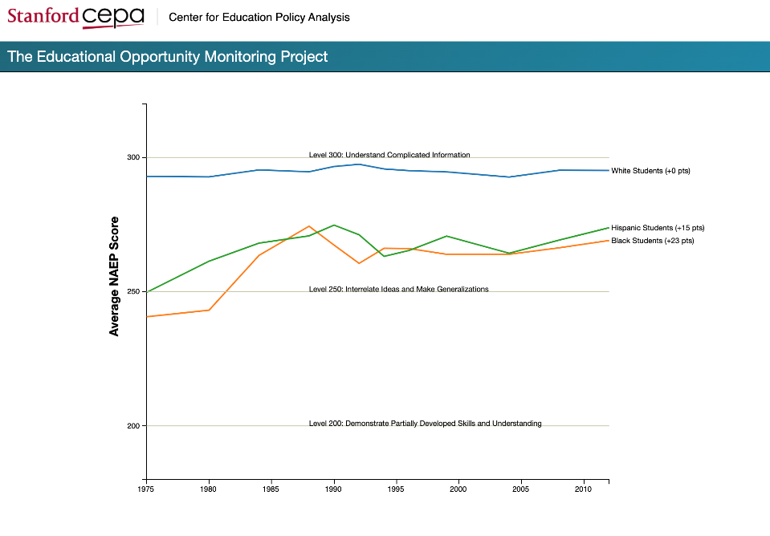
Reading scores,
17 year olds
Time
Notes:
Nicole

Slide 8
High School Graduation Rates
89.1% of all White students graduate
79.0% of all Black students graduate
Only 67% of Black D.C. students graduate (lowest in country)
81.0% of all Hispanic students graduate
U.S. Dept. of Education, 2017-2018 data

Slide 9
Notes:
Derek
ACLU data:
Black students bear the brunt of the school to prison pipeline.
Black students are only 15% of the student population BUT

Slide 10
Notes:
Derek
New data on 2015-2016 says that black students are suspended on average 5 times more than white students.

Slide 11
Important Frame for the Conversation
Notes:
Derek

Slide 12
What does this have to do with special education?
Notes:
Nicole

Slide 13
What’s the purpose of special education?
The purpose of special education is to make education accessible to ALL children
By providing evidence-based, individualized educational services and accommodations to children with disabilities
Notes:
Nicole
Special ed is supposed to prepare kids for further education, independent living, or employment.

Slide 14
DCPS is Majority Minority; White Supremacy doesn't exist here!
Morgan and Farkas suggest that teachers may be reluctant to refer students for special education for fear of seeming racist.
Source:https://www.edweek.org/ew/articles/2016/06/01/are-there-too-few-minorities-in-special.html
Notes:
Derek
- Please add the slide about black educators perpetuating similar patterns.
(grounded in DC)
Sept 2017, REPORT Race, poverty, and interpreting overrepresentation in special education
Paul L. Morgan is an associate professor of education at Pennsylvania State University. George Farkas is a professor of education at the University of California, Irvine.

Slide 15
Perceptions of Black Boys A mixed-method study investigated the impact of student race in the determination of eligibility of emotional disturbance as recommended by school psychologists.
The idea of the disproportionately high number of Black boys identified as having an ED disability is a socially accepted norm within the public education system.
What has also been a socially accepted norm within the public education system is how their White counterparts and those who are responsible for teaching them in general view Black boys.
Black boys are seen as aggressive, unmanageable, and problematic in the school setting. This view is not just reflective of White people, but by Black people as well.
Source:https://fisherpub.sjfc.edu/cgi/viewcontent.cgi?article=1146&context=education_etd
Notes:
Derek
It is possible that Black educators do not socially accept or can relate to their low economic Black students.
A racist trope inside the African-American community.
Therefore, it leaves the idea that this normalcy, also known as the oppression found within our public education system, is not solely based on race, but also class.

Slide 16
IDEA Disability categories have been unchanged since the 1960s
autism;
deaf-blindness;
deafness;
emotional disturbance;
hearing impairment;
intellectual disability;
multiple disabilities;
orthopedic impairment;
other health impairment;
specific learning disability;
speech or language impairment;
traumatic brain injury; or
visual impairment (including blindness).
Notes:
Nicole
As Derek Johnson explained, these are the disability categories that a child must meet the criteria of in order to be deemed eligible for special education.
These disability categorizations were created by policy makers in 1960s, and they haven’t changed since then, despite new research coming out about disabilities and health conditions.
These categories are not evidence-based. In fact, there is no Emotional disturbance disorder anywhere in the DSM-5 (Diagnostic and Statistical Manual of Mental Disorders ), the reference manual that the majority of health care professionals use to diagnose patients.

Slide 17
What is Emotional Disturbance?
a condition exhibiting one or more of the following characteristics over a long period of time and to a marked degree that adversely affects a child’s educational performance:
(a) An inability to learn that cannot be explained by intellectual, sensory, or health factors.
(b) An inability to build or maintain satisfactory interpersonal relationships with peers and teachers.
(c) Inappropriate types of behavior or feelings under normal circumstances.
(d) A general pervasive mood of unhappiness or depression.
(e) A tendency to develop physical symptoms or fears associated with personal or school problems. The term includes schizophrenia.
Source: https://campoidea14.weebly.com/definitions.html
Notes:
Derek

Slide 18
Subjective = Influenced by personal feelings, tastes, or opinions
In studies focused on Critical Race Theory, rationales provided by psychologists who recommended the classification of emotionally disturbed for Black students included comments that did not have substantial objective data to support the criteria.
Criteria included the:
acknowledgment that the student is missing instruction, but still needs the classification;
resources in general education were exhausted so, the student must need classification;
the student’s case is complicated and a chaotic home life justifies classification.
Source: https://fisherpub.sjfc.edu/cgi/viewcontent.cgi?article=1146&context=education_etd
Notes:
Derek
However, the opposite recommendation was made for the White student when these comments were noted.

Slide 19
Black children are disproportionately labeled “Emotionally Disturbed”
Notes:
AND….
Nicole

Slide 20
Some Key Stats on Emotional Disturbance
“African-American children are identified as having mental retardation and emotional disturbance at rates greater than their White counterparts.”
In 2016, 12% of Black children across the nation received services at school for ED.
Only 8.5% of White children received those services.
Sources: Ferri & Connor, 2005In the Shadow of Brown: Special Education and Overrepresentation of Students of Colorhttps://hechingerreport.org/new-studies-challenge-the-claim-that-black-students-are-sent-to-special-ed-too-much/
Notes:
Nicole

Slide 21
Some Key Stats on ED (cont’d)
ED is problematic because the special education system usually fails to give children labeled with ED the support that they need to access their education and make educational progress.
71% of young adults with “emotional disturbance” are stopped by police.
43.2% are arrested within six years after high school.
Further, young adults with ED are more likely to be stopped by police, arrested, incarcerated, or placed on probation or parole within six years after high school than young adults in any other disability category.
Notes:
Derek
Discuss prevalent issues DC Metro Police and kids with disabilities in getting to and from school.

Slide 22
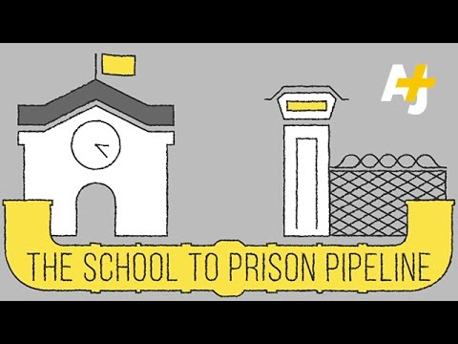
The system sends ED kids down the School-to-Prison Pipeline
ED kids
Notes:
Nicole
The special education system seems to send ED kids into the school to prison pipeline!
There is a fundamental problem with the way that schools and the special education system treat ED kids.

Slide 23
Disproportionality
Disproportionality is defined as the “overrepresentation” and “under-representation” of a particular population or demographic group in special or gifted education programs relative to the presence of this group in the overall student population.
(National Association for Bilingual Education, 2002).
Notes:
Derek

Slide 24
Bottom Line: Black children are underserved by special education
Notes:
Derek
A new study by independent groups of scholars find that students of color are actually less likely than similar white students to be identified as having disabilities and obtain special education services at schools (especially true if you control for behavior and academic performance)

Slide 25
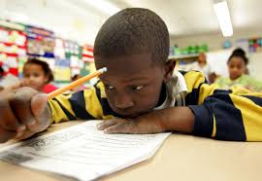
Bottom Line: Black children are underserved by special education. . .
Black children are disproportionately less likely than white children to be identified as having disabilities and obtaining special education services at schools.
Notes:
Nicole

Slide 26
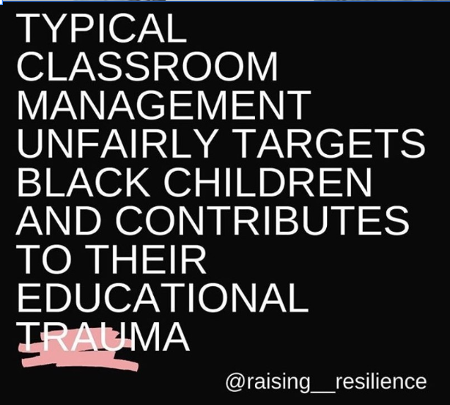
What are your personal experiences navigating the special education system as counsel for Black students?
Notes:
Derek – 5 minute discussion.
What are your personal experiences in navigating the special ed system with clients?
PAUSE: generate discussion. (What brought them here today? What concerns do you have regarding the educational system and how it treats children of color?)

Slide 27
Is it Time that IDEA’s disability labels and Concepts are updated?
Notes:
Pause
Nicole
It’s been about 60 years since those labels were created.

Slide 28
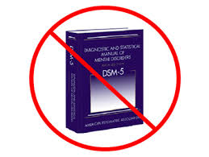
What is “emotional disturbance” describing anyway?
Notes:
Nicole
Pause
It’s not in the DSM

Slide 29
How could education and special education become more effective for Black children?
Notes:
DEREK
What do you think?
PAUSE
Discussion

Slide 30
What else feeds the STP pipeline?
TRAUMA
Notes:
Nicole
Trauma does
Nicole
As a special education attorney, I noticed that most of the children who did the worst in terms of the school to prison pipeline were the ones who had the toughest home lives or had otherwise experienced the worst adversity, from abandonment by parents to having a brother murdered.
Why is it that most of the children who are most stuck in the school-to-prison pipeline experiencing the highest levels of trauma?
What is the connection between trauma and problems at school?
What is the connection between trauma and disability?

Slide 31
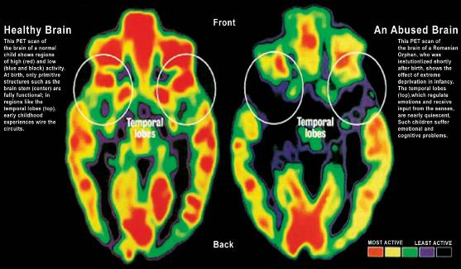
New Research reveals how Trauma leads to problems in learning and behavior
Notes:
Nicole
These problems can worsen pre-existing disabilities. These problems can constitute disabilities.
Hurt people hurt others

Slide 32
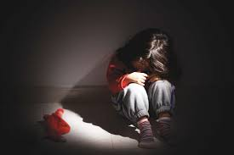
Trauma is…
Any event that overwhelms the child’s ability to cope with the experience and elicits feelings of terror, powerlessness, and out-of-control physiological arousal
Typically occurs when a child is faced with an intense, frightening event that threatens or causes harm to the child or another’s physical or psychological well-being and the child lacks sufficient support from others to cope.
Can be episodic or occur over a long period of time.
Notes:
Nicole
A severe emotional response to a frightening or threatening event or series of experiences that leaves a person overwhelmed and unable to cope.
Children have the least coping skills and are thus the most vulnerable.

Slide 33
Adversity in any form can be trauma if it causes long-term harm
Poverty and lack of access to basic necessities
Dysfunction at home: domestic violence, neglect, physical/sexual/emotional abuse, substance use, incarceration of a family member, untreated mental health problems in a family member, parental separation, removal from primary caretakers
Community violence: abuse by police, gang & drug activity, bullying
Medical: Covid-19 death and illness, chronic illness, medical procedures, major injuries and illnesses.
Educational: Expulsion, suspension, arrest,
retention, bullying
Notes:
Derek
Poverty: uncertainty/insecurity about getting basic needs met (such as shelter, food, health coverage, adequate education, etc.)

Slide 34
Adversity in any form can be trauma if it causes long-term harm
Environmental: lack of green or recreational space, blighted housing, poor housing conditions, climate change, natural disasters, homelessness
Immigration: parental deportation, family separation, forced placement in boarding schools
Structural oppression: abuse by police, mass incarceration, barriers to voting, inadequate educational and employment opportunities
Historic trauma: slavery, the Holocaust, forced displacement, family detention,
Intergenerational trauma: passed through families
Notes:
Derek
Poverty: uncertainty/insecurity about getting basic needs met (such as shelter, food, health coverage, adequate education, etc.)
Explain what historic and intergenerational trauma are, noting that Black children are vulnerable to the historic and intergenerational impact of slavery.

Slide 35
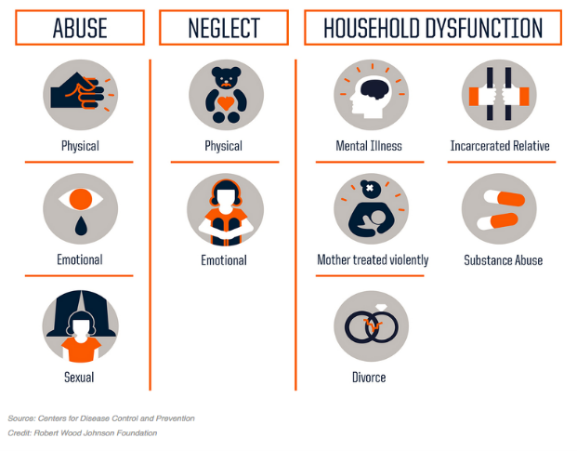
Trauma is common
2 of 3 American adults have at least 1 Adverse Childhood Experience (ACE):
Notes:
Nicole
Research shows that trauma is common.
In the late 90s, 17,421 insured, primarily white, educated, employed people with health insurance described their childhood experiences with 10 ACES.
The more ACES, the more disease, disability, and earlier death.
Not all ACES are trauma, but the ACES that cause long-term harm are trauma.

Slide 36
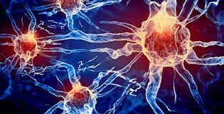
Trauma’s impact on children is broader than originally thought
Causes toxic stress, disability, disease, early death
Changes the brain’s architecture
Disrupts ability to form trusting relationships
Causes hypersensitivity to threat
non-threatening stimuli → fight/flight/freeze mode
Sensory processing and language problems
Notes:
Nicole
Hundreds of studies have shown that
It causes toxic stress, disability, disease, and in some, early death by over-activating the stress-response system, and causing inflammation in multiple body systems, and changing gene expression, leading to health problems and health-harming behaviors.
Trauma Over-activates and dysregulates the stress-response system → toxic stress → the brain’s architecture changes so that:
The parts of the brain responsible for fear, anxiety, and impulsivity overproduce neural connections
Trauma undermines development of the parts of brain needed for school success, including executive functioning (attention; learning from experience, measured judgment, planning, organizing); memory; self-regulation; making decisions; sequential thinking; language development
Decreases the number of neural connections made during development. So less brain volume is detected in those parts.
Due to the vulnerability of the developing brain to extreme and chronic stress, children’s brains are disproportionately impacted by trauma.
Causes hypersensitivity to threat (children become triggered by non-threatening stimuli)
fight/flight/freeze mode
Triggers include: loud noises; getting in trouble

Slide 37
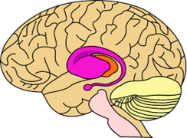
Trauma impairs success at school
Impairs learning
Impairs executive function, memory, language development, and sensory processing
Impairs behavior
Increases impulsivity and hypersensitivity to threat (fight/flight/freeze response)
Impairs logical and sequential thinking
Impairs development of healthy relationships
Notes:
Nicole
Behavior: trauma can manifest in fighting, disrespectful language, opposition and defiance, leaving classroom or school, or other behaviors.

Slide 38
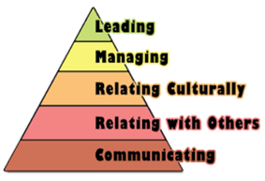
Executive Functioning Problems Affect School Performance
Difficulty:
concentrating in school
accomplishing tasks at school
remembering what’s taught
completing homework
pursuing goals
→ Poorer grades and test scores, less likely to graduate
Impulse control problems
Problems in controlling behavior
→ Discipline problems
→ More likely to be incarcerated
Notes:
Nicole
32 times as likely to have learning and behavior problems at school if 4+ ACES
Trauma makes more likely:
Language and verbal processing deficits
Reading impairments
Delays in expressive and receptive language
Poor social skills
Impulsive behavior
Performing below grade level
Lower grades
Failing a grade
Referral for special education services
Dropout and failure to graduate
Suspension, expulsion
Arrest at school and involvement with delinquency and criminal justice systems

Slide 39
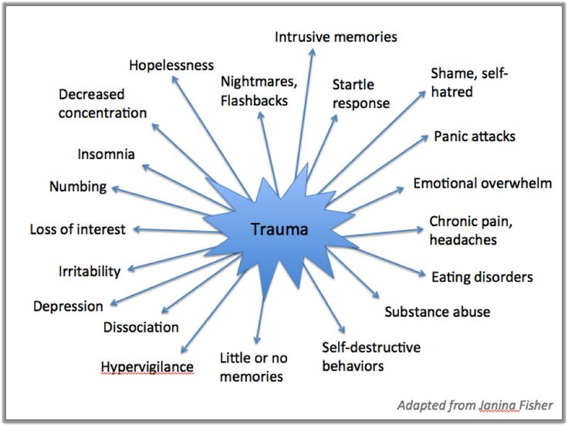
Trauma is associated with many mental health effects and diagnoses
→ depression, anxiety, PTSD
→ ADHD
→ oppositional defiant disorder,
conduct disorder,
reactive attachment
disorder
“Developmental Trauma” is a proposed diagnosis
Notes:
Nicole
Diagnoses associated with trauma: ADHD,” anxiety/depression, bipolar disorder, eating disorders, PTSD, oppositional defiance disorder, intermittent explosive disorder, conduct disorder
Not surprised that many kids who have experienced trauma end up with an ED categorization.
A kid can have multiple of these types of diagnoses, but what’s really happening is that the child is struggling from the effects of trauma.
Trauma is a source of stress, distraction, and maladaptive behavior

Slide 40
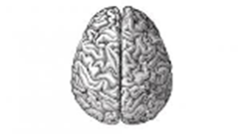
Trauma impairs language development
Trauma impairs the development of brain connections needed for language development.
Traumatized children often have less developed verbal skills than non-verbal reasoning skills.
Notes:
Nicole – How do you think trauma impacts language development?
These children have difficulty using words to express their emotions and instead behaviorally act out their feelings
Important to distinguish between willful behavior and skills deficits

Slide 41
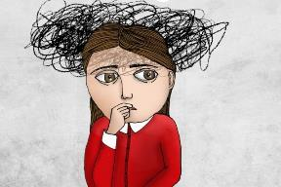
Impacts on Sensory Development
Over or Under Response to:
Sounds
Lights
Touch
Pain
Inability to verbally express what body is feeling:
Hunger
Exhaustion
Anger
Fear
Hyper or hypo arousal to both sensory stimuli and trauma triggers
Notes:
Nicole

Slide 42
Trauma Impacts Social-Emotional Development
Struggle to regulate emotions
Feel unsafe…respond with
Fight
Flight
Freeze
Inability to trust others
Misinterpret social cues…to the negative
Lack empathy/compassion
Pervasively negative self view and world view
Notes:
Nicole

Slide 43
Trauma Delays Development
Developmental delays are common (50%) among children in the child welfare system:
Cognitive
Gross and fine motor skills
Sensory
Emotional/behavioral dysregulation
Notes:
Derek
50% according to NSCAW

Slide 44
Trauma→ Academic & Behavioral Problems
Notes:
Nicole
There was a 2010 Spokane, WA ACES study: the effects of childhood trauma first become evident in school. More than half of those with ACE scores of 4 or more reported having learning or
behavioral problems, compared with 3 percent of those with a score of zero.
Study on Adverse Childhood Experience and Developmental Risk in Elementary Schoolchildren
2101 children in ten elementary public schools in Spokane, Washington
This study involved 2100 children in 10 elementary schools in Spokane WA in late 2010. Found that trauma was common in children’s lives, where trauma included divorce, homelessness, witnessing family violence, involvement with child protective services (neglect/abuse) a family member abusing alcohol or other drugs, incarceration of a family member, mental illness in a family.
Trauma was the MAIN reason that a child missed school or got into trouble, and it was the second-highest predictor of academic failure (behind placement in special ed classes).
And the more stressors a kid had the more likely the child was to have failing grades, poor attendance, severe behavior problems, and poor health.
The 248 kids with 3 or more adverse childhood experiences had 3 times the rate of academic failure, five times the rate of severe attendance problems, six times the rate of school behavior problems, and four times the rate of poor health compared with children with no known trauma.

Slide 45
Trauma → Truancy & Suspensions
2010 Spokane Adverse Childhood Events Study
Notes:
Nicole
TO ILLUSTRATE:
There was a 2010 Spokane, WA ACES study: the effects of childhood trauma first become evident in school. More than half of those with ACE scores of 4 or more reported having learning or
behavioral problems, compared with 3 percent of those with a score of zero.
Study on Adverse Childhood Experience and Developmental Risk in Elementary Schoolchildren
2101 children in ten elementary public schools in Spokane, Washington
This study involved 2100 children in 10 elementary schools in Spokane WA in late 2010. Found that trauma was common in children’s lives, where trauma included divorce, homelessness, witnessing family violence, involvement with child protective services (neglect/abuse) a family member abusing alcohol or other drugs, incarceration of a family member, mental illness in a family.
Trauma was the MAIN reason that a child missed school or got into trouble, and it was the second-highest predictor of academic failure (behind placement in special ed classes).
And the more stressors a kid had the more likely the child was to have failing grades, poor attendance, severe behavior problems, and poor health.
The 248 kids with 3 or more adverse childhood experiences had 3 times the rate of academic failure, five times the rate of severe attendance problems, six times the rate of school behavior problems, and four times the rate of poor health compared with children with no known trauma.

Slide 46
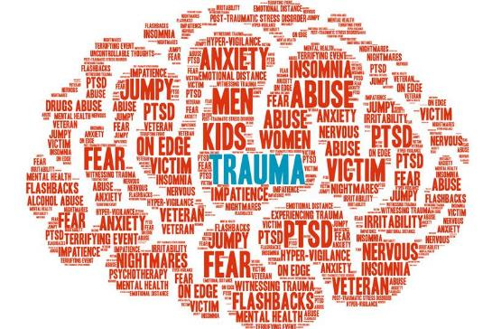
How might trauma be showing up in your practice?
Notes:
Derek – 10 minute discussion
Pause

Slide 47
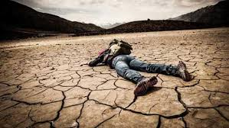
Trauma’s effects are adaptive, not pathological
Promoting survival when a child feels threatened at home or in the community
But they are problematic for learning and behaving well in the classroom.
Notes:
Nicole
One thing to remember is: trauma’s effects are Adaptive, Not pathological
A trauma-responsive approach to behavior recognizes that trauma-related symptoms and behaviors are an individual’s best and most resilient attempt to manage, cope with, and rise above an experience of trauma.
Hypervigilance, paying lots of attention to sensory input, quick action, fight/flight/freeze, being triggered, lower brain thinking… is adaptive.

Slide 48
Understanding trauma shifts the question
From “What’s wrong with you?”
To “What happened to you, and how can I help?”
Notes:
Nicole

Slide 49
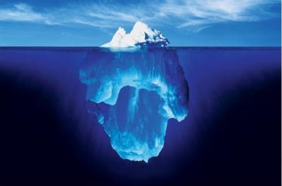
Trauma’s effects on behavior are often misinterpreted by schools
Notes:
(skip this and next two slides if no time)
This and next two slides are optional.

Slide 50
“Child Challenges Authority – is Disrespectful” or “Disruptive”
Triggered and is in FIGHT
Dysregulated and is STUCK
Anxious, feeling unsafe
In a survival state
Not able to process
Sensory overload
Filled with shame and fear about making a mistake
Notes:
Educators might think that a child who challenges authority is disrespectful or disruptive when in reality, the child is triggered and in a fight or flight mode, dysregulated and is stuck in that dysregulation. The child is likely feeling anxious and unsafe and is in a survival state, unable to process, and overloaded with sensory input. The child is likely filled with shame or fear about making a mistake.

Slide 51
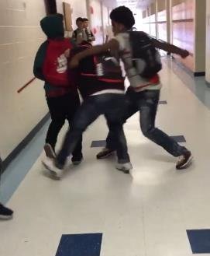
“Child intentionally hurt others” and “acted with intent and forethought”
Triggered and in FIGHT
Acting without thinking (impulsively), not thinking logically or about consequences
Lower-brain thinking
In a survival state
Dysregulated
Notes:
When teachers see these behaviors, they automatically imbue behavior with malicious intent, making it easier for them call the police. White children tend to get more of the benefit of the doubt. Less moral judgment/blaming of white children.
Educators might think that a child intentionally hurt others or acted with intent and forethought when really, the child might be triggered and in a fight or flight mode. The child is likely to be acting without thinking, dysregulated, and in a survival state of mind.

Slide 52
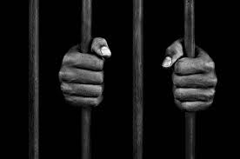
Trauma feeds the school to prison pipeline
Youth in the delinquency system have disproportionate rates of trauma
OJJDP reports that 93% of juvenile offenders report at least 1+ ACE; average of 6 ACES
1/3 of juvenile offenders report exposure to multiple types of trauma per year
Parental divorce and experiencing physical abuse leads to higher rates of self-reported total offending, violent offending, and property offending
Girls in the juvenile justice system are disproportionately victims of sexual violence.
Notes:
Nicole
Higher risk of reoffending in those with higher ACE scores
http://www.journalofjuvjustice.org/JOJJ0302/JOJJ0302.pdf

Slide 53
But, there’s hope: Trauma can be healed
Effects not necessarily permanent
“Post-traumatic growth” and healing are possible
Improves learning, behavior, and relationships
Responses should be trauma-specific and evidence-based
Trauma-specific therapy
Create an environment that prioritizes
Physical and emotional safety
Trusting, caring relationships
A sense of belonging, acceptance, and inclusion
De-escalation and emotional regulation
Unconditional positive regard and support
Avoiding harsh punishments
Notes:
Nicole
A child should feel that a school has their back, will support them unconditionally.

Slide 54
School should be a place of solace and healing
Trauma-responsive education is the “greatest hope” for traumatized children – Bessel Van der Kolk
Notes:
Derek
Bessel Van Der Kolk trauma expert who wrote book called “The Body Keeps the Score.”

Slide 55
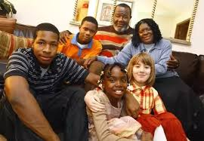
Is trauma-responsive education a legal imperative?
Notes:
Nicole
Most children won’t get any mental health services in school unless they have an IEP (have special education). (This is the case in Georgia, for instance).
Special education is sometimes the only space where schools start becoming trauma-sensitive.

Slide 56
Special Education was designed to be evidence-based
IDEA and Section 504/ADA
Notes:
Nicole

Slide 57
Schools must identify and educate children with disabilities
IDEA and Section 504/ADA MANDATE that schools:
Locate, evaluate, and provide an individualized education to EVERY child with a disability, even if that disability stems from trauma.
Notes:
Nicole
The law requires school districts to find all children with a disability who need special education – that includes children impaired by trauma

Slide 58
Trauma can be a disability under the law
Under Section 504,
Disability = ANY significant physical or mental impairment of a major life activity, such as thinking
Courts have supported the notion that trauma and adversity causes disability
Peter P v. Compton Unified School District, 135 F. Supp. 3d 1098, 111-12 (C.D. Cal. 2015)
Stephen C. v. Bureau of Indian Education, No. CV-17-08004–PCT-SPL, 2018 U.S. Dist. LEXIS 68083 (D. Ariz. Mar. 29, 2018).
Trauma “can result in physiological effects constituting a physical impairment that” amounts to a disability under Section 504.
Notes:
Nicole
Trauma can constitute a disability under special education law. Section 504 makes this especially true.
2 major lawsuits that have pushed entire school districts to become trauma-responsive.
Peter P. v. Compton
Stephen
Central District of California in Peter P. v. Compton Unified School District23 held that student plaintiffs had plausibly alleged that they were individuals with a “disability” within the meaning of Section 504 due to the effects of trauma and that plaintiffs’ claims of disability discrimination under Section 504 were sufficient to survive the school district’s motion to dismiss. Similarly, the U.S. District Court for the District of Arizona in Stephen C. v. Bureau of Indian Education24 denied in part a motion to dismiss by holding that complex trauma and adversity “can result in physiological effects constituting a physical impairment that substantially limits major life activities within the meaning of Section 504 of the Rehabilitation Act.”25

Slide 59
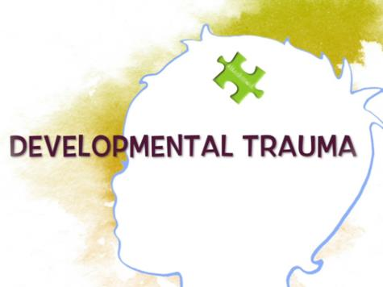
What if IDEA has a trauma-specific disability category?
To help educators understand the cause of so much disability and how to address it.
Notes:
Nicole
Developmental trauma has been proposed by psychologists and there has been work to make it a part of the DSM-V
It could be non-stigmatizing and help to inform educators about the cause of disability and how to heal it.
Special education law is ready to incorporate recent findings about trauma

Slide 60
How can advocates help special education to be more trauma-informed
For a particular student?
Throughout the school system?
Notes:
Derek
Small group discussion with large group debrief

Slide 61
How can an IEP become trauma-responsive?
Goal = make school a safe place for the child
Minimizing triggers
Identify “safe-place” and safe-place staff person
Help the child to feel supported rather than targeted by school
Avoid morally judging the child
Build a child’s relationships and sense of belonging at school
Allow child to take breaks to de-escalate and self-regulate
Use FBAs and BIPs to address triggered behaviors
Explicitly require trauma-informed therapy and services
Explicitly require teaching about trauma & self-regulation skills
Notes:
Nicole
Goal = make school a safe place for children. The goal is for school to be a solace.
Explicitly describe how trauma impacts the child’s disability and functioning
Explicitly require trauma-informed services
Cognitive behavioral interventions for trauma in schools (CBITS)
Explicitly require the teaching of self-regulation skills
Teach about the impact of trauma
Teach about flipping the lid – everyone flips their lid. It’s not bad or shameful. The more that a part of the brain gets used, the stronger it gets. The thinking brain can override the emotional reaction. The more you practice, the easier it gets
Flipping one’s lid is about feeling threatened – it’s about fear and hurt. Kids are trying not to get hurt; not trying to hurt.
Identify who will be the “safe-base” staff person (like a counselor, special education teacher, or school nurse) when feelings overwhelming
The safe place is where the child can go where there is someone who cares about him/her.
Who can help child de-escalate and self-regulate
Give child permission to leave class to go to this adult
Allow child take breaks to de-escalate (in IEP or behavioral intervention plan)
Don’t withdraw services if those services are needed to make child feel safe at school
Consider home-visits by teachers to promote relationship between school and parent and child

Slide 62
How can an IEP become trauma-responsive? (cont’d)
Annual goals should build skills in self-regulation, healthy relationships, executive functioning, and self-advocacy
Assign an adult or peer mentor
Dedicated aide trained in de-escalation and promoting the sense of safety
Occupational therapy and speech and language services may be needed
Notes:
Nicole
Goal = make school a safe place for children. The goal is for school to be a solace.
Explicitly describe how trauma impacts the child’s disability and functioning
Explicitly require trauma-informed services
Cognitive behavioral interventions for trauma in schools (CBITS)
Explicitly require the teaching of self-regulation skills
Teach about the impact of trauma
Teach about flipping the lid – everyone flips their lid. It’s not bad or shameful. The more that a part of the brain gets used, the stronger it gets. The thinking brain can override the emotional reaction. The more you practice, the easier it gets
Flipping one’s lid is about feeling threatened – it’s about fear and hurt. Kids are trying not to get hurt; not trying to hurt.
Identify who will be the “safe-base” staff person (like a counselor, special education teacher, or school nurse) when feelings overwhelming
The safe place is where the child can go where there is someone who cares about him/her.
Who can help child de-escalate and self-regulate
Give child permission to leave class to go to this adult
Allow child take breaks to de-escalate (in IEP or behavioral intervention plan)
Don’t withdraw services if those services are needed to make child feel safe at school
Consider home-visits by teachers to promote relationship between school and parent and child
For children who are triggered at school:
Look at misbehavior from the perspective of whether the child was triggered into a fight/flight response (child trying to protect him/herself vs. intentionally trying to do bad)
Identify the reminders of the trauma in functional behavioral assessments (FBAs). We need trauma-informed FBAs.
Be sensitive to cues in the school environment that may cause a reaction in the child
Help child self-regulate when triggered (take deep breaths, take a break/walk, mindfulness, carry a stack of books, fidget, use a signal to ask for a break, mindfulness) - this requires flexibility
Teach child about what triggers him/her
Anticipate difficult times and provide additional support
Ex: “safe-base” staff person
Ex: “safe-space” corner
Example: for children who don’t like being a lone, provide a partner to accompany him/her going to the restroom
Warn children if you are doing something out of the ordinary, such as turning off the lights or making a sudden loud noise
Create a behavioral intervention plan (BIP) that focuses on promoting self-regulation
Calming down
Feeling safe and secure emotionally and physically
Train school staff to avoid flipping their lid when the child flips his/her lid.
If child feels threatened by other students, create a safety plan to identify ways to promote a sense of safety (and actual safety)
Consider a change of placement to a less overwhelming, calmer place with fewer children, stronger relationships with adults, or more structure
Be careful about putting lots of traumatized children together → they can end up triggering one another and undermining efforts to create a safe environment.
Wherever the child is placed, try to get all of the children on-board with creating a safe space for all
A trauma-informed dedicated aide could help the child to self-regulate
Requires training
Dedicated aide needs to learn the triggers that cause the child to start fight/flight response
Disciplinary responses should help teach skills in executive functioning, verbalizing (rather than acting out) feelings, taking responsibility, and self-regulating one’s emotions.
Train all school staff in trauma-informed practices (including coaches, bus-drivers, cafeteria workers)
Employ restorative justice practices
Point systems/token economies, incentives and consequences can backfire because they create shaming when the child doesn’t meet expectations (and fails to teach self-regulation) – relationships are much more powerful
Avoid excluding child through suspension/expulsion (can be traumatic for the child and reduces the supports that surround them)
For children struggling with executive functioning, consider:
Shortening assignments
Providing class notes/outline before class
Giving step-by-step instructions and have student report them back
Creating a daily routine that doesn’t change
Allowing additional time to complete assignments and tests
Providing additional support for organizing and remembering assignments (posting assignments online or in a notebook/binder that parents/teacher can check)
Break down big assignments into smaller pieces with deadlines
Allowing the student to choose wear to sit in classroom
Have student create a daily to-do list
Dedicated Aide

Slide 63
Minimize triggers of trauma at school:
Feeling Unheard/Feeling Attacked
Being spoken to in certain tones/Yelled at by Authority Figures
Bullying
Not Being Treated Equitably
Social Isolation
Seclusion, restraint
Student Resource Offices (SROs)
Micro Aggressions
Witnessing Violence
Metal Detectors in Schools
Environmental Racism
Notes:
Derek
Your advocacy could help explain how triggers impact a child. You could also work to minimize a child’s exposures to triggers at school.
Also: Does medication play a role in education traumas? I think it can. It is overused and misused in many instances, I’m not the medical professional between the two of us so I’ll let Professor Tuchinda say a few words.

Slide 64
Evidence-based, Trauma-specific interventions
Cognitive Behavioral Intervention for Trauma in Schools (CBITS)
Support for Students Exposed to Trauma (SSET)
Child-parent psychotherapy
treats both the parent(s) and the child as a team
Notes:
Derek

Slide 65
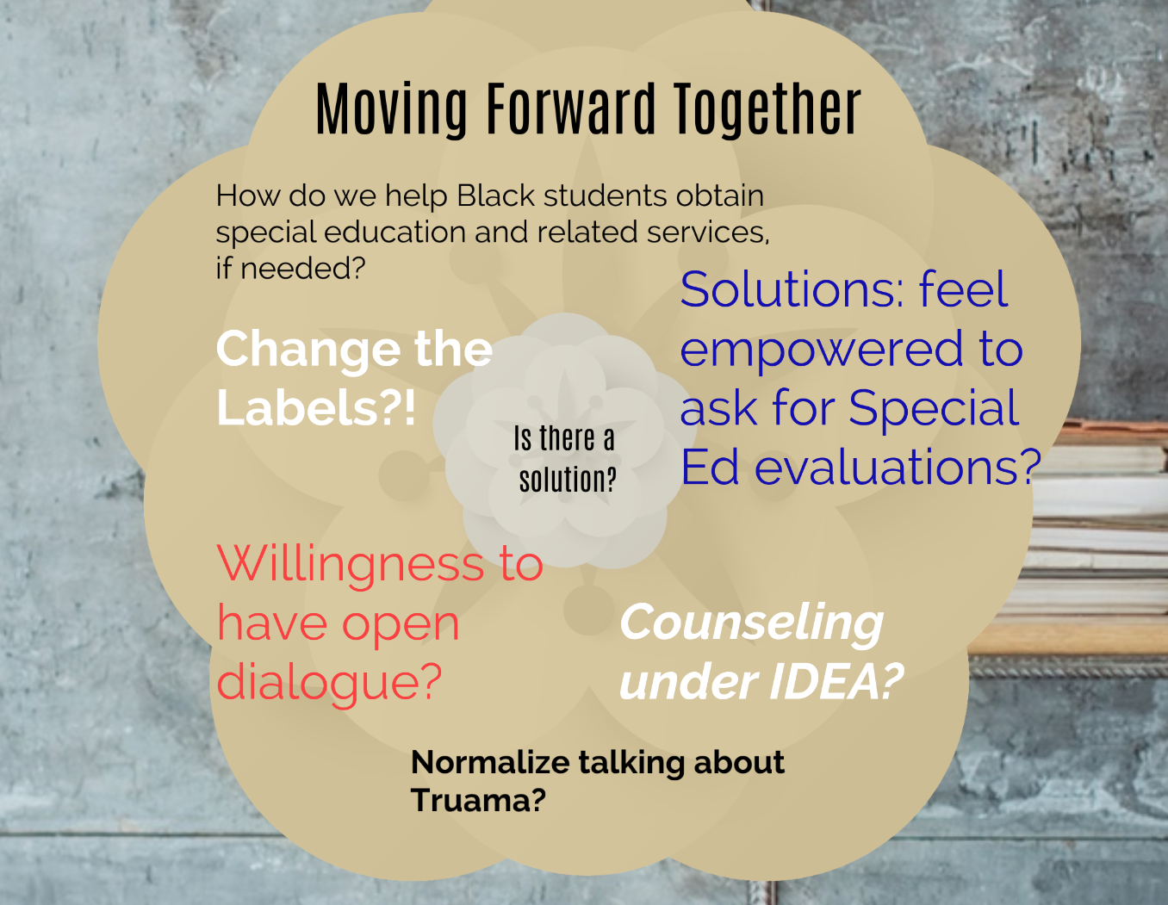
Notes:
Derek

Slide 66
Students are primed to learn when they feel safe, connected, and supported at school, and that is best achieved through a whole-school approach (Ristuccia, 2013)
Notes:
Nicole

Slide 67
Push for Systemic Change
Make trauma-responsive services school-wide (and community-wide)
Prioritize educating about trauma and how to address it
Stop suspending/expelling children
Replace cops in schools with counselors in schools
End school seclusion and restraint
Create a trauma-specific disability categorization
“Developmental trauma”
Eliminate “emotional disturbance” category
Notes:
Nicole
Trauma-informed services need to be school-wide (not just in special education)

Slide 68
Push for Systemic Change (cont’d)
Make special education more evidence-based
School-based health clinics
Medical-legal partnerships
Whole-school trauma-responsiveness
Community trauma-responsiveness
Notes:
Nicole
Trauma-informed services need to be school-wide (not just in special education)

Slide 69
Recent lawsuits have asked for
Comprehensive training, coaching, and consultation for all staff in trauma-informed and culturally sensitive strategies
Use of restorative practices
Employment of counselors trained to identify students with mental-health difficulties
Adoption of practices to enhance student wellness, created in partnership with community members

Slide 70
Being trauma-responsive works!
Decreased suspensions and arrests
Higher graduation rates and better grades
- Watch “Paper Tigers” film
Notes:
Nicole

Slide 71
Reparations for trauma
Kamala Harris
https://www.npr.org/2019/03/14/703299534/sen-kamala-harris-on-reparations
Notes:
https://www.npr.org/2019/03/14/703299534/sen-kamala-harris-on-reparations
Derek

Slide 72
Be the change you wish to see in the world.
- Mahatma Gandhi
Notes:
Derek
(reminder to take personal responsibility)

Slide 73
To be anti-racist is to be trauma-responsive
To be trauma-responsive is to be anti-racist
Notes:
Nicole

Slide 74
Resources/Reading
Tuchinda article, “The Imperative for Trauma-Responsive Special Education” in NYU Law Review June 2020 issue
My Grandmother’s Hands by Resmaa Menakem
Beyond Behaviors by Mona Delahooke
The Trauma-Informed School by Sporleder & Forbes
Help for Billy by Heather Forbes
The Body Keeps the Score by Bessel Van der Kolk
The Deepest Well by Nadine Burke Harris
Childhood Disrupted by Donna Jackson Nakazawa
Caste by Isabel Wilkerson

